Slide 1
CSE 225
AVL Tree

Slide 2
Problem with Binary search tree
The disadvantage of a binary search tree is that its height can be as large as N-1
This means that the time needed to perform insertion and deletion and many other operations can be N times in the worst case.
We want a tree with small height.
A binary tree with N node has height at least log₂ ( N+1)-1
Thus, our goal is to keep the height of a binary search tree log₂ ( N) times
Such trees are called balanced binary search trees. Examples are AVL tree, red-black tree.

Slide 3
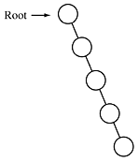
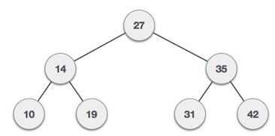
Binary search tree
balanced Tree
Unbalanced Tree

Slide 4
AVL
There is a need to maintain the binary search tree to be of balanced height, so that it is possible to obtain for the search option of log₂ ( N) time in the worst case.
One of the most popular balanced tree was introduced by Adelson velskii and landis (AVL)

Slide 5
AVL Tree
An empty binary search tree is an AVL tree
A non empty binary tree T is an AVL tree iff T^{L} (left subtree) and T^{R} (right subtree ) of T and h(T^{L} ) (height of left subtree) and h( T^{R} ) (height of right subtree ) where | h(T^{L} ) - h( T^{R} ) | <= 1
Balance factor BF is difference between h(T^{L} ) and h( T^{R} ) and the value will be -1, 0 or +1.
BF = h(T^{L} ) - h( T^{R} )
50
BF = 3-2 =1
T^{L}
T^{R}
h=2
h=3

Slide 6
AVL Tree
5
3
Not AVL Tree
1
4
5
3
8
AVL Tree
1
4
10

Slide 7
AVL Tree- Balance Factor
BF = h(T^{L} ) - h( T^{R} )
LH for left high (+1) to indicate that the left subtree is higher than the right subtree
EH for even high (0) to indicate that the subtrees are the same height
RH for right high (–1) to indicate that the left subtree is shorter than the right subtree.

Slide 8
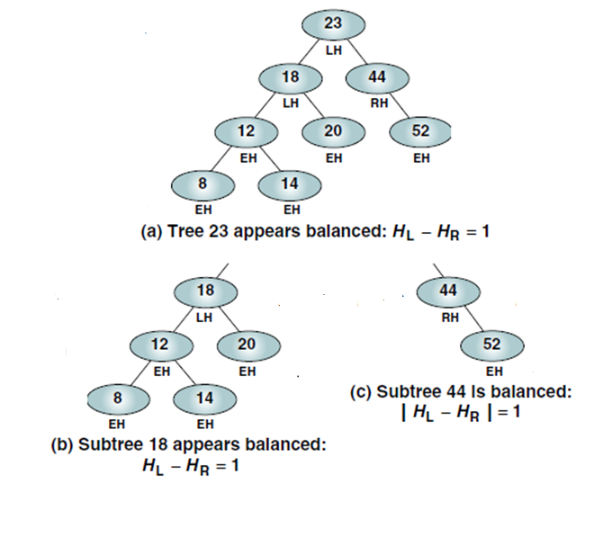
AVL Tree- Balance Factor

Slide 9
Balancing Trees
Whenever we insert or delete a node from a tree, the resulting tree may be unbalanced.
We must rebalance it.
AVL trees are balanced by rotating nodes either to the left or to the right.
All unbalanced trees fall into one of these four cases:
Left of left: Inserted node is in the left subtree of left subtree of node A
Right of right: Inserted node is in the right subtree of right subtree of node A
Right of left: Inserted node is in the right subtree of left subtree of node A
Left of right: Inserted node is in the left subtree of right subtree of node A

Slide 10
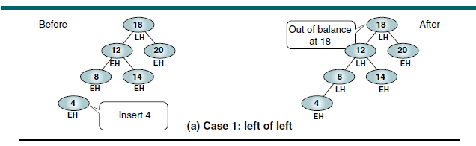
Balancing Trees
Out of balance AVL Tree

Slide 11
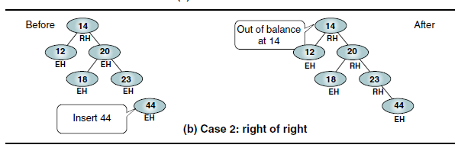
Balancing Trees
Out of balance AVL Tree

Slide 12
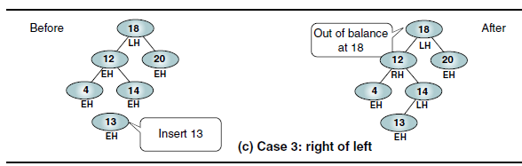
Balancing Trees
Out of balance AVL Tree

Slide 13
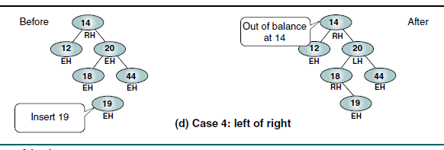
Balancing Trees
Out of balance AVL Tree

Slide 14
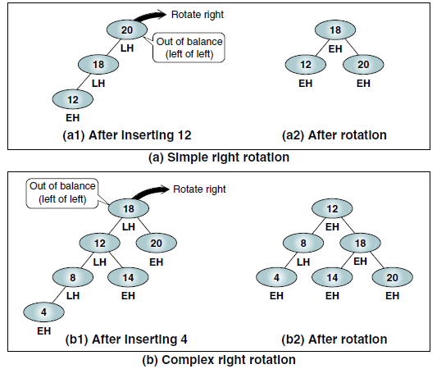
Balancing Trees- Left of Left
When the out-of-balance condition has been created by a left high subtree of a left high tree, we must balance the tree by rotating the out-of-balance node to the right.

Slide 15
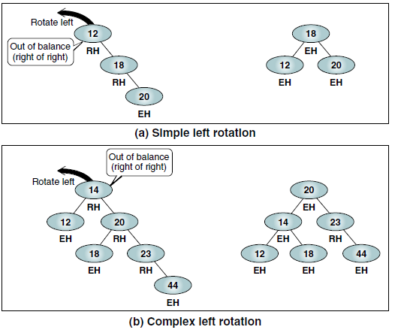
Balancing Trees- Right of Right
When the out-of-balance condition has been created by a right high subtree of a right high tree, we must balance the tree by rotating the out-of-balance node to the left.

Slide 16
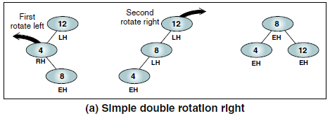
Balancing Trees- Right of Left
When the out-of-balance condition has been created by a right high subtree of a left high tree, we must balance the tree by rotating two nodes, one to the left and one to the right, to balance the tree.

Slide 17
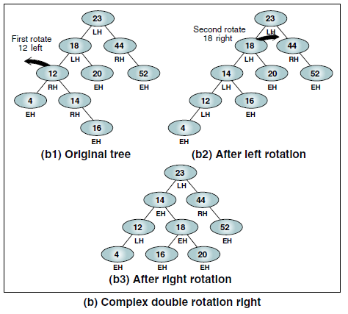
Balancing Trees- Right of Left

Slide 18
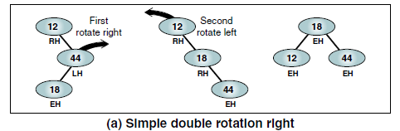
Balancing Trees- Left of Right
When the out-of-balance condition has been created by a lefthigh subtree of a right high tree, we must balance the tree by rotating two nodes, one to the right and one to the left.

Slide 19
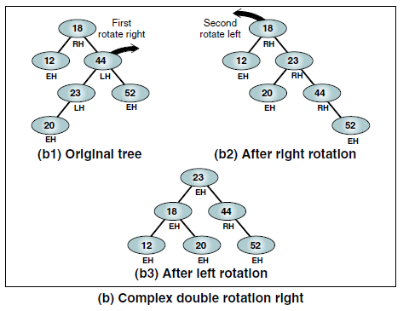
Balancing Trees- Left of Right

Slide 20
Extended Example
Insert 3,2,1,4,5,6,7, 16,15,14
3
3
2
3
Fig 1
2
2
1
3
Fig 4
Fig 2
1
2
2
Fig 3
1
3
1
3
Fig 5
Fig 6
4
4
5

Slide 21
2
2
1
4
1
4
3
5
3
5
Fig 8
Fig 7
6
4
4
2
5
2
5
1
3
6
1
3
6
4
Fig 10
Fig 9
7
2
6
1
3
5
7
Fig 11

Slide 22
4
4
2
6
2
6
1
3
5
7
1
3
5
7
Fig 12
16
Fig 13
16
4
15
2
6
1
3
5
15
Fig 14
16
7

Slide 23
4
2
6
1
3
5
15
4
Fig 16
7
16
2
7
1
3
14
6
15
5
14
16
Fig 17

Slide 24
Deletion
Delete by a BST deletion by copying algorithm.
Rebalance the tree if an imbalance occurs.
There are three deletion cases:
Deletion that does not cause an imbalance.
Deletion that requires a single rotation to rebalance.
Deletion that requires two or more rotations to rebalance.

Slide 25
AVL Tree Example:
Insert 14, 17, 11, 7, 53, 4, 13 into an empty AVL tree
14
11
17
7
53
4

Slide 26
AVL Tree Example:
Insert 14, 17, 11, 7, 53, 4, 13 into an empty AVL tree
14
7
17
4
11
53
13

Slide 27
AVL Tree Example:
Now insert 12
14
7
17
4
11
53
13
12

Slide 28
AVL Tree Example:
Now insert 12
14
7
17
4
11
53
12
13

Slide 29
AVL Tree Example:
Now the AVL tree is balanced.
14
7
17
4
12
53
11
13

Slide 30
AVL Tree Example:
Now insert 8
14
7
17
4
12
53
11
13
8

Slide 31
AVL Tree Example:
Now insert 8
14
7
17
4
11
53
8
12
13

Slide 32
AVL Tree Example:
Now the AVL tree is balanced.
14
11
17
7
12
53
4
8
13

Slide 33
AVL Tree Example:
Now remove 53
14
11
17
7
12
53
4
8
13

Slide 34
AVL Tree Example:
Now remove 53, unbalanced
14
11
17
7
12
4
8
13

Slide 35
AVL Tree Example:
Balanced! Remove 11
11
7
14
4
8
12
17
13

Slide 36
AVL Tree Example:
Remove 11, replace it with the largest in its left branch
8
7
14
4
12
17
13

Slide 37
AVL Tree Example:
Remove 8, unbalanced
7
4
14
12
17
13

Slide 38
AVL Tree Example:
Remove 8, unbalanced
7
4
12
14
13
17

Slide 39
AVL Tree Example:
Balanced!!
12
7
14
4
13
17

Slide 40
In Class Exercises
Build an AVL tree with the following values:
15, 20, 24, 10, 13, 7, 30, 36, 25

Slide 41
15, 20, 24, 10, 13, 7, 30, 36, 25
20
15
15
24
20
10
24
13
20
20
13
24
15
24
10
15
13
10

Slide 42
15, 20, 24, 10, 13, 7, 30, 36, 25
20
13
13
24
10
20
10
15
7
15
24
7
30
13
36
10
20
7
15
30
24
36

Slide 43
15, 20, 24, 10, 13, 7, 30, 36, 25
13
13
10
20
10
20
7
15
30
7
15
24
24
36
30
25
13
25
36
10
24
7
20
30
15
25
36

Slide 44
Remove 24 and 20 from the AVL tree.
13
13
10
24
10
20
7
20
30
7
15
30
15
25
36
25
36
13
13
10
30
10
15
7
15
36
7
30
25
25
36

Slide 45
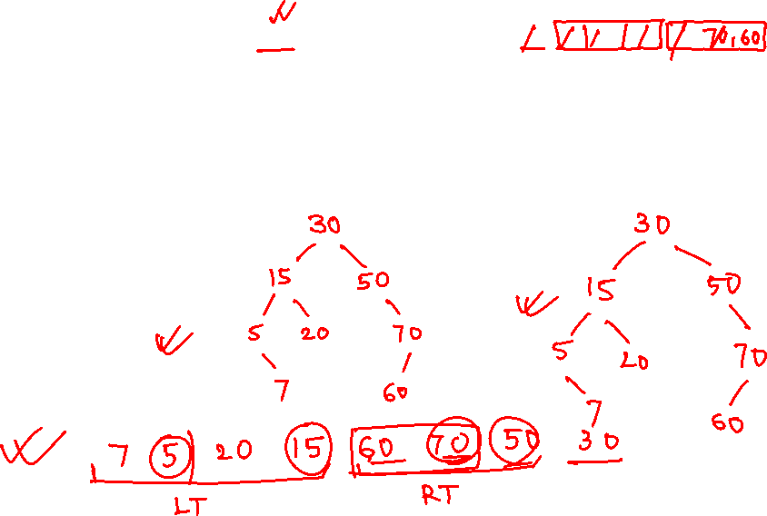
The preoreder traversal on a BST returns the sequence - 30, 15, 5, 7, 20, 50, 70, 60. What is the sequence returned by a post order traversal? Write your answer in the textbox below.

Slide 46
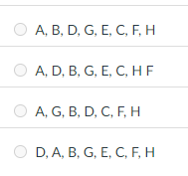
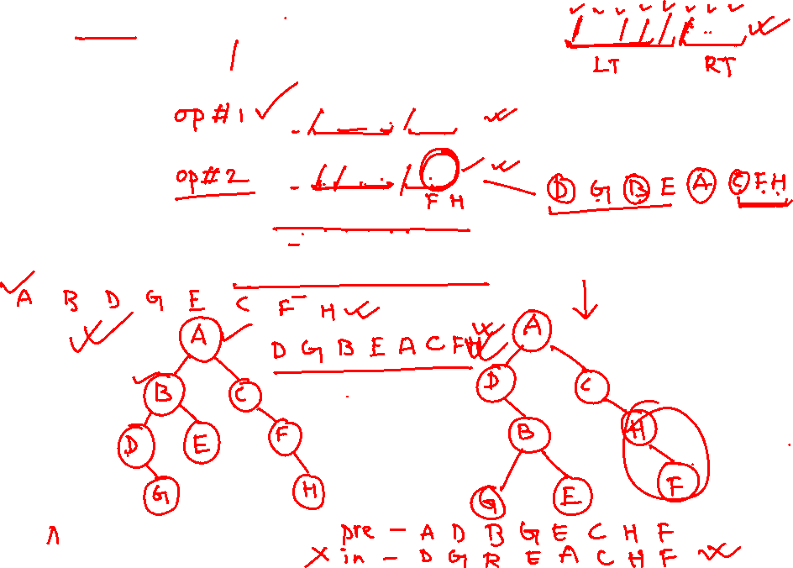
The inorder traversal of a binary tree returns the sequence - D, G, B, E, A, C, F, H.
What is the sequenced returned by the preorder traversal?

